Slide 1
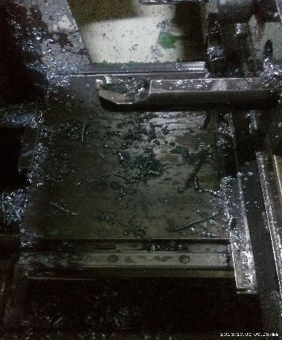
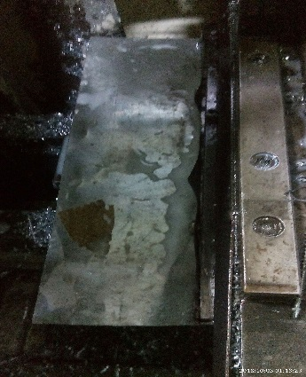
P15
TPM CIRCLE NO :- 01
ACTIVITY
KK
QM
PM
JH
SHE
OT
DM
E&T
KAIZEN IDEA SHEET
TPM CIRCLE NAME:Achiver
LOSS NO. / STEP
DEPT :- ASSEMBLY
RESULT AREA
P
Q
A
C
D
S
M
CELL:- A202 LEV
CELL NAME:- Fuel cock
MACHINE / STAGE :-CNC Machine
OPERATION :-Turning
KAIZEN THEME : To eliminate down time on power mate.
IDEA :- provide guard for slide
Problem present status :On power mate on y axis and x axis alarm for axis overloaded
COUNTERMEASURE:-
1) New guard to be provided to avoid burr enter
BENCHMARK
1/ month
TARGET
0
KAIZEN START
20.9.2016
TDC
TEAM MEMBERS: Mahesh deshmane,walunj
,Sachin Choudhri,vinod
KAIZEN FINISH
26.9.2016
BENEFITS :-
Breakdown time eliminate
Productivity improve
Before
After
KAIZEN SUSTENANCE
WHY - WHY ANALYSIS :-
Why1 :-Axis overload alarm
Why2 :-slide jam
Why3 :- burr entrapped in slide mechanism
Why4:- No guard provided
WHAT TO DO:-Check point added in Sustenance audit check sheet.
HOW TO DO:- check visualy
FREQUENCY :Daily
RESULT :-
Slide over loaded breakdown eliminate
Productivity improve
ROOT CAUSE: No guard provision on slide
REGISTRATION NO. & DATE 20.9.2016
SCOPE & PLAN FOR HORIZONTAL DEPLOYMENT
REGISTERED BY: Mahesh deshmane
SR.
NO.
CELL
TARGET
RESPONSIBILITY
STATUS
MANAGER’S SIGN: d.pawar
1
NA
NA
NA
NA

